Slide 1
SC1015 Mini-Project
Superheroes — Marvel or DC?
SC6, Group 10
Clement Tan Kang Hao
Darren Ng Joon Kai
Denzyl David Peh

Slide 2
Introduction
01
Our Motivation

Slide 3
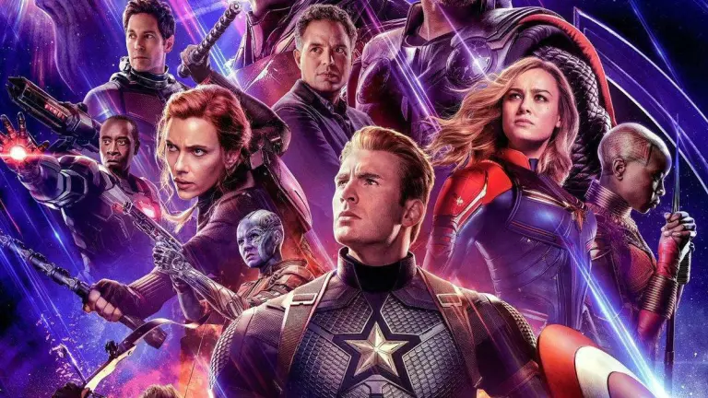
Why did we choose superheroes?

Slide 4
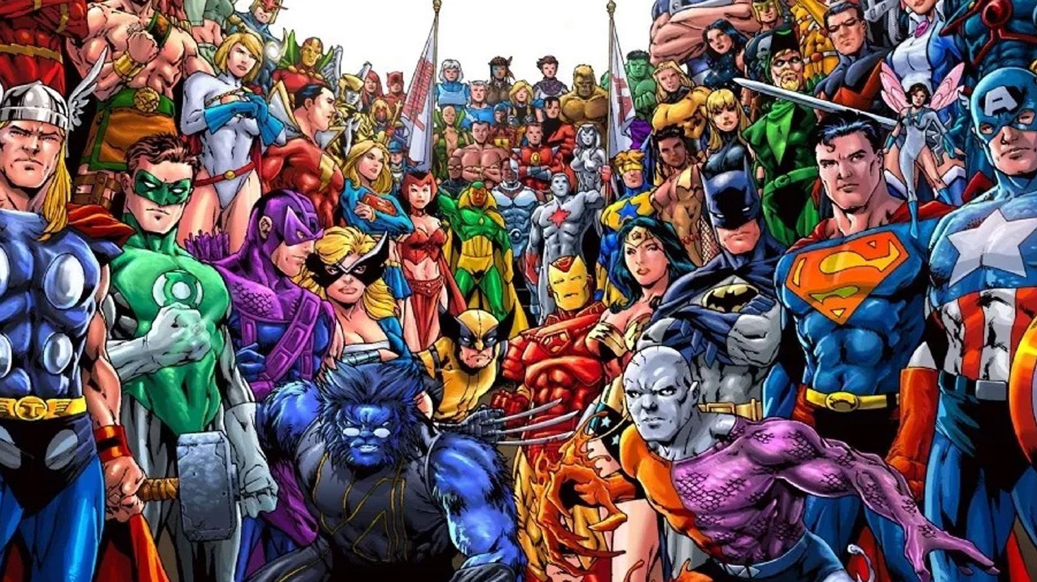
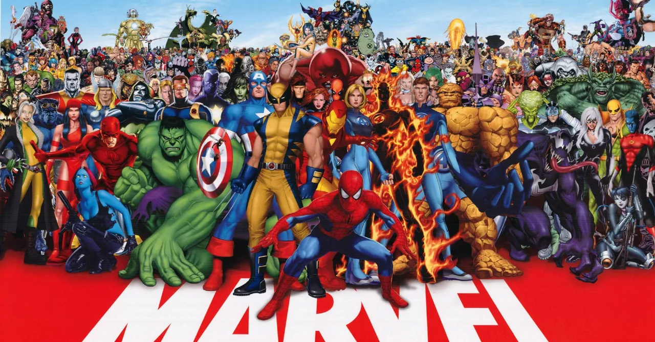
Our Motivation
Huge collection of superheroes
Myriad of information on each and every superhero
Hard to analyse by hand

Slide 5
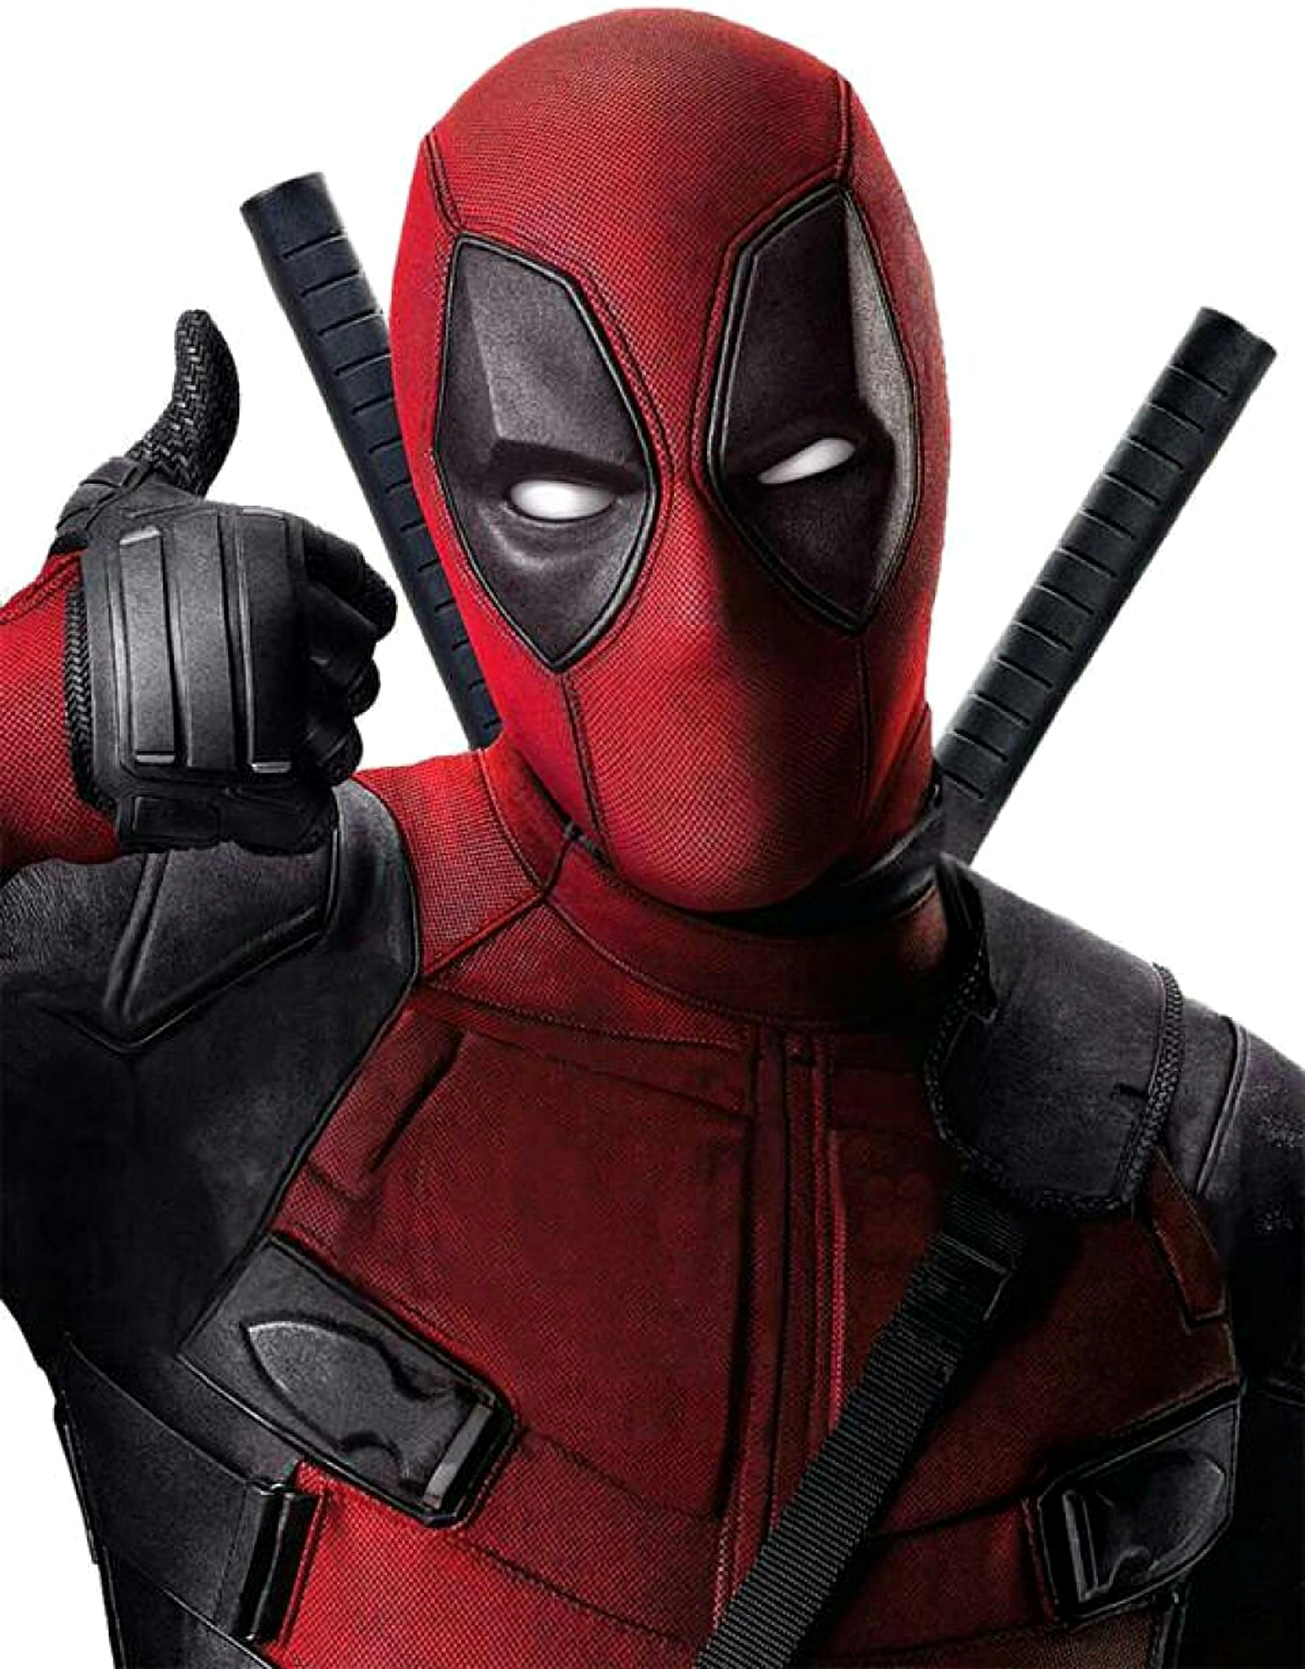
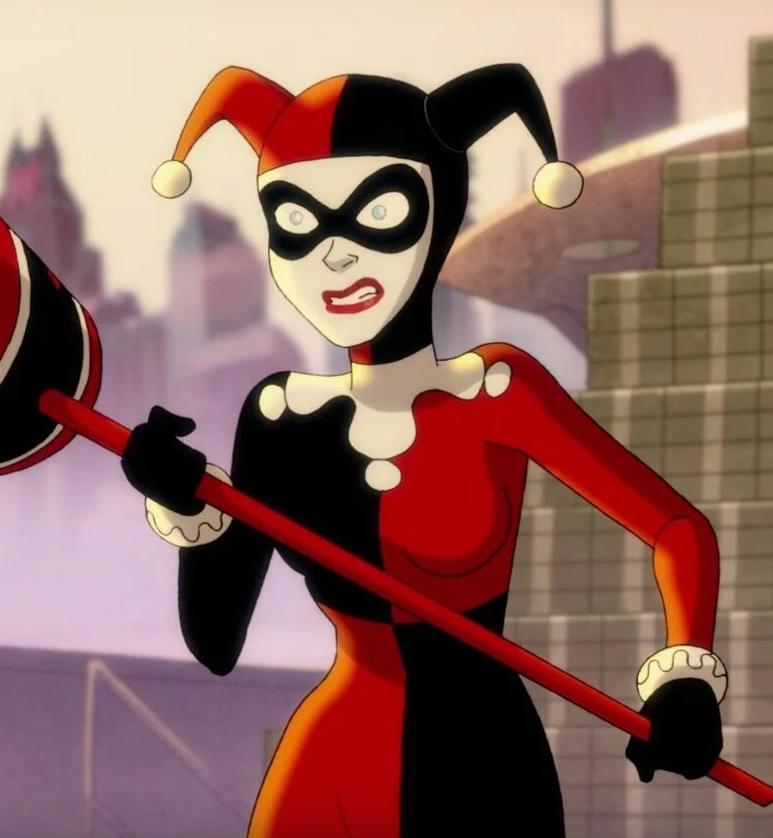
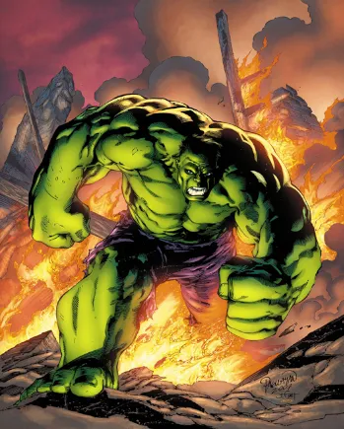
Which universe (Marvel/DC) does a superhero belong in?
Are we able predict it?
The Question
Are there any writing styles?
Why are some superheroes so popular?

Slide 6
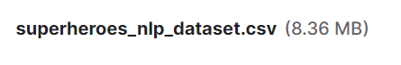


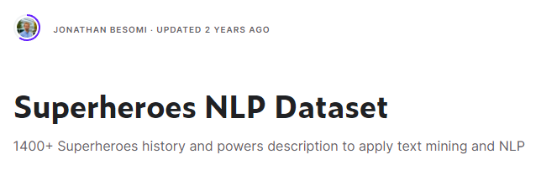
The Dataset
https://www.kaggle.com/datasets/jonathanbesomi/superheroes-nlp-dataset?datasetId=633089&sortBy=voteCount&select=superheroes_nlp_dataset.csv

Slide 7
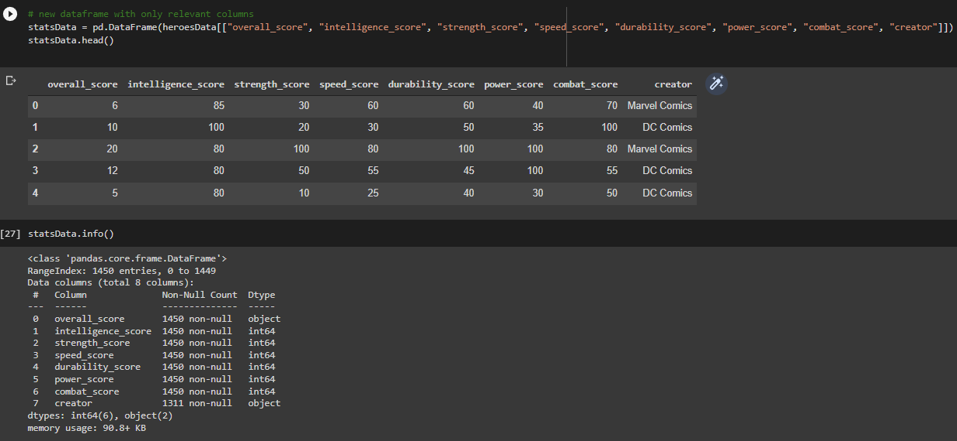
Data Preparation - Cleaning
Numeric Score Variables used
To be Predicted
Noticed that there is an anomaly with the ‘overall_score’ type

Slide 8
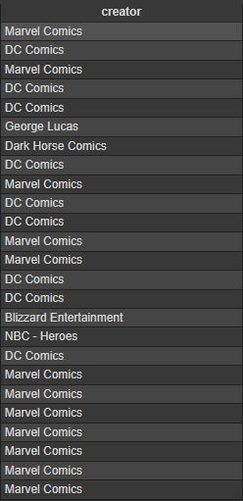
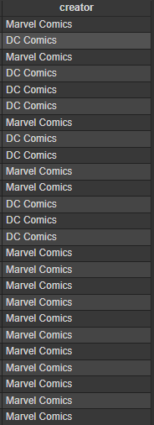
Data Preparation - Cleaning
Begin focusing on 2 most significant creators,
‘DC Comics’ & ‘Marvel Comics’
Reduced to 975 rows
Notes:
With all NaN values out of the way, we can now begin focusing on the 2 main creators, marvel and DC.

Slide 9
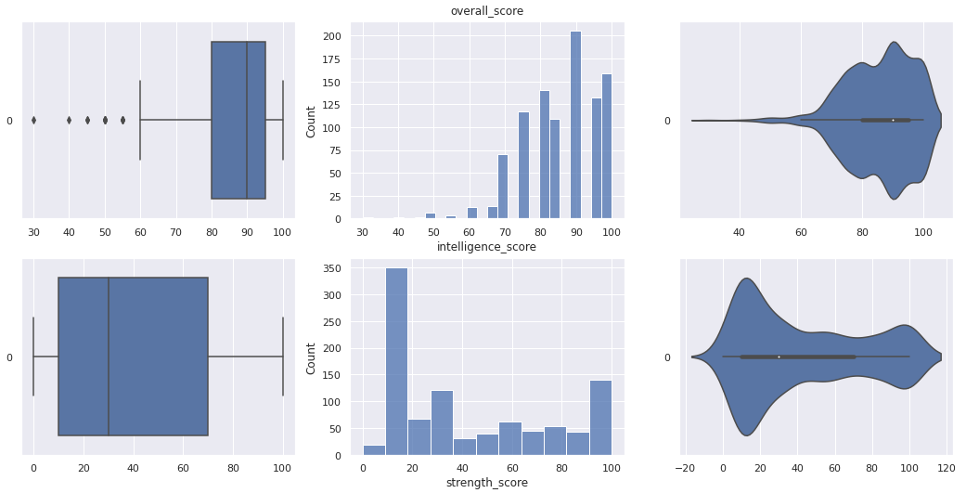
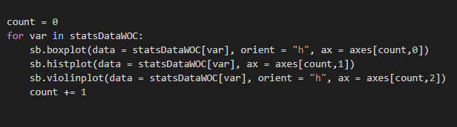
Exploratory Analysis - Univariate Exploration
Frequency distributions of heroes and each attribute
Using boxplot(), histplot() and violinplot() for each attribute

Slide 10
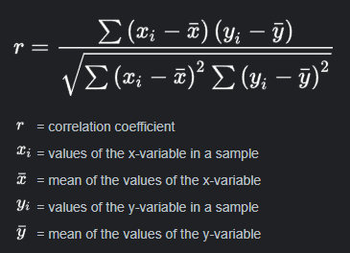
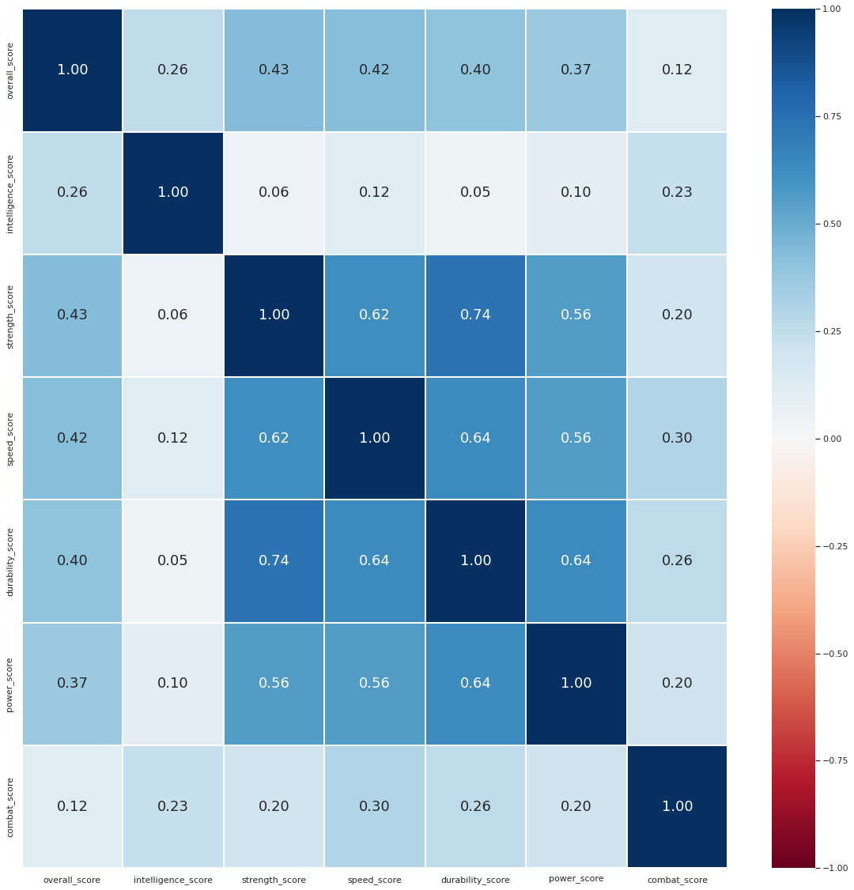
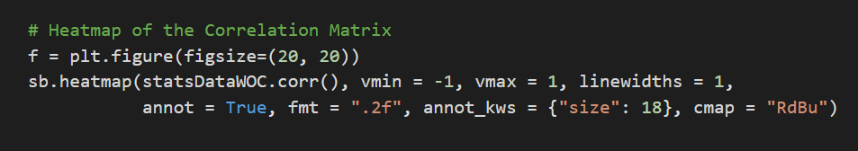
Exploratory Analysis - Multivariate Exploration
Using corr() to display correlation matrix
Shows us the pearson correlation coefficients, r
Positive Correlation
Using seaborn to visualise the correlations
overall_score intelligence_score strength_score
overall_score 1.000000 0.255080 0.434460
intelligence_score 0.255080 1.000000 0.059490
strength_score 0.434460 0.059490 1.000000
speed_score 0.423537 0.122865 0.620062
durability_score 0.400231 0.053290 0.738799
power_score 0.368750 0.097858 0.556646
combat_score 0.118166 0.228708 0.198596
speed_score durability_score power_score combat_score
overall_score 0.423537 0.400231 0.368750 0.118166
intelligence_score 0.122865 0.053290 0.097858 0.228708
strength_score 0.620062 0.738799 0.556646 0.198596
speed_score 1.000000 0.635030 0.557411 0.304439
durability_score 0.635030 1.000000 0.637833 0.261345
power_score 0.557411 0.637833 1.000000 0.204408
combat_score 0.304439 0.261345 0.204408 1.000000
Negative Correlation

Slide 11
Machine Learning
03
- Decision Trees
- Natural Language Processing (NLP)

Slide 12

Why Decision Trees?
Decision Trees
Linear Regression
Capable of covering classification and regression
More suited for predicting labels
Only capable of solving regression problems
Only suited for predicting a quantity

Slide 13
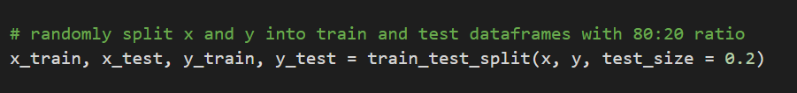
Decision Tree Creation
1
2
3
4
5
DecisionTreeClassifier from scikit-learn
Using a train test split of
80% Train (780)
20% Test (195)
.fit(x_train,y_train) to train the model
.predict() to predict y with x, using the model
Calculate TPR, FPR, TNR, FNR
X – Numeric Hero Attribute Scores
Y – Creators
Calculate Classification Accuracy
Plot confusion matrix using seaborn

Slide 14
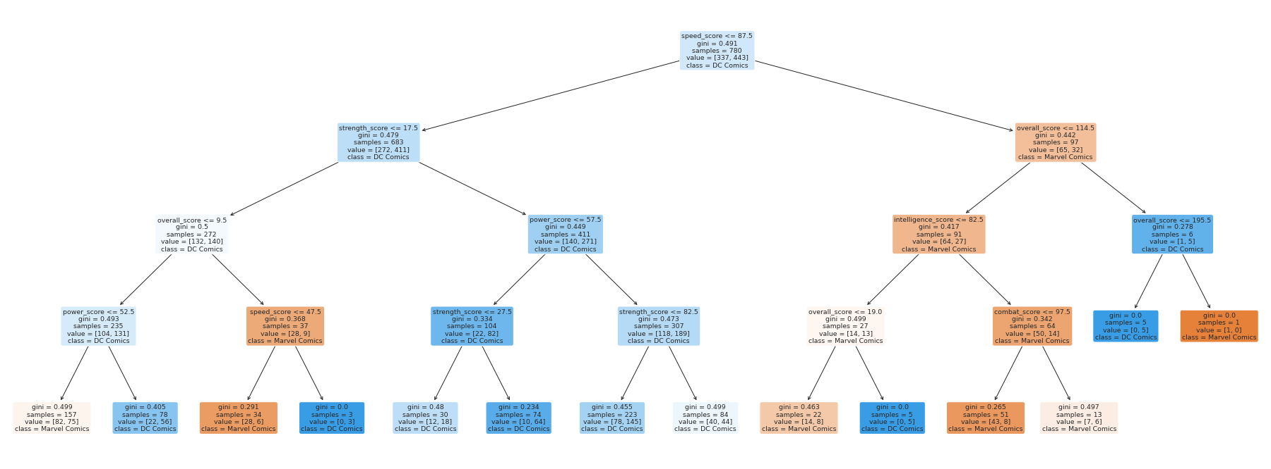
Decision Tree Creation

Slide 15
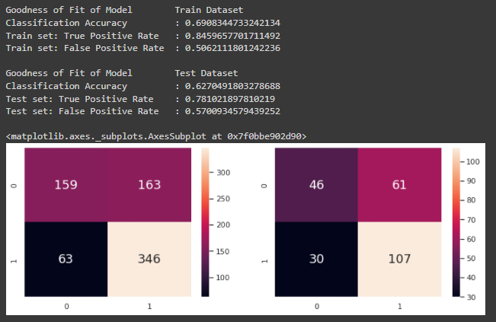
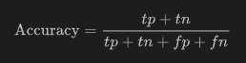
Decision Tree Findings
63%
57%
Using a train test split of
80% Train (780)
20% Test (195)
Classification accuracy of about
High false positive rate of about

Slide 16
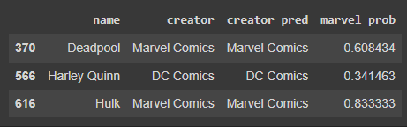

Decision Tree Findings
Actual Creator
Predicted Creator
Probability of being created by Marvel
Although correct predictions but with low classification accuracy means it is due to luck.
Probability of predicting the right creator averages around 70% of the time

Slide 17
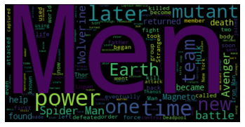
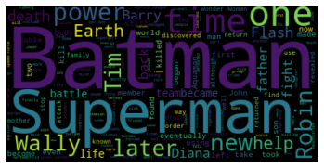
Decision Tree Findings
Decision Tree helps us achieve our goal but…
Low classification accuracy
High false positive rate
Feels more like luck-based
Natural Language Processing (NLP)
The ability to predict DC/Marvel based on each hero’s own description!
Boast a much higher prediction accuracy from our findings
Could use a model that is more robust and accurate.

Slide 18
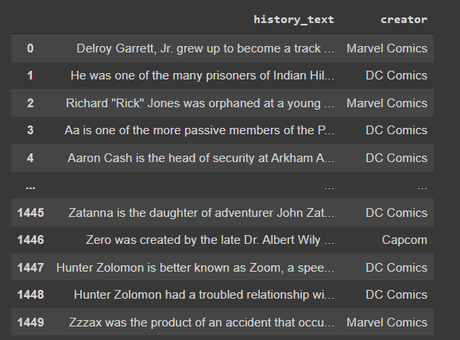
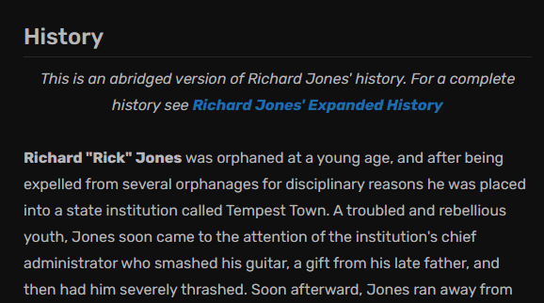

NLP – Our Approach
Data Size: 997

Slide 19
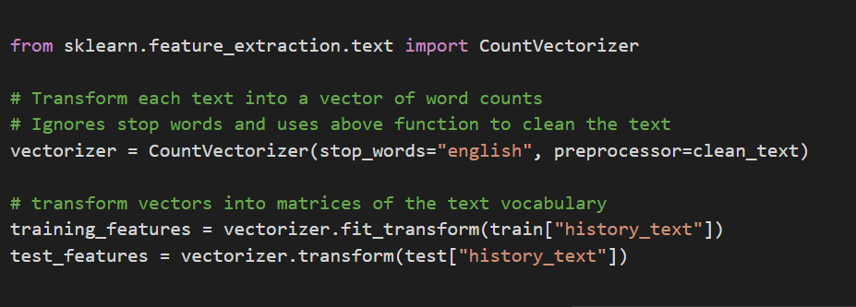
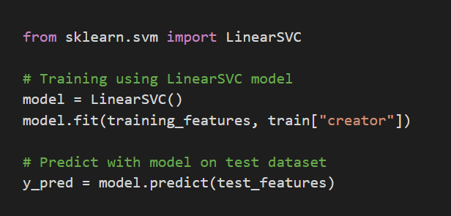
NLP – Our Approach
1
2
3
4
5
Clean text
Transform each history text into vectors
CountVectorizer from scikit-learn
Fit train data using LinearSVC Model
LinearSVC from scikit-learn
Predict model on test data
Calculate Classification Accuracy

Slide 20
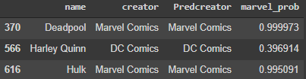
NLP Findings
Actual Creator
Predicted Creator
Probability of being created by Marvel
Decision Tree (Depth = 4)
Significantly higher prediction probability
No longer luck-based
More meaningful addition to our analysis
NLP

Slide 21
Improving the ML Models – Point Estimation
Point Estimation to ensure consistency since…
Model created is dependent on the random split of train and test data subsets
Varying accuracy could be erroneous

Slide 22




Improving the ML Models – Point Estimation
Decision Tree Model
Repeat Random Split 30 times
Using Central Limit Theorem to assume Normal Distribution
Decision Tree Model
Calculate p-values and z-scores
Record Classification Accuracy values
Calculate 95% Confidence Interval
NLP Model

Slide 23
Improving the ML Models – Point Estimation
99%
95%
Statistics from point estimation
z-score and p-value:
Confidence interval
Significance Level of
Confidence Level of

Slide 24
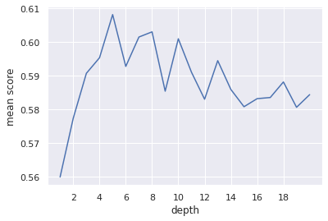
Improving the Decision Tree – Optimal depth
What is the most optimal depth to prevent underfitting and overfitting?
By rebuilding the tree with depths ranging from 1 to 20…
Observed that most optimal depth is around 5!

Slide 25
Conclusion
04

Slide 26


Takeaways from the Project
Predictable difference between the heroes between Marvel and DC
Insights and understandings may even be used to predict future heroes
VS

Slide 27
Decision tree VS NLP
Classification Accuracy
True Positive Rate
False Positive Rate
0%
25%
63%
75%
100%
85%
Average Accuracy of prediction between Decision tree and NLP
68%
92%
Average Probability that an actual positive will test positive
Decision Tree
NLP
44%
Average Probability that it is negative but predicted as positive
10%

Slide 28

Motivation and Inspiration
This project has greatly…
Inspired us to try more advanced NLP models in the future!
Motivated us to do self-learning to find better solutions!
01
02

Slide 29
THANK YOU

